Slide 1

6th Grade Math
Unit 12, Lesson 4 Writing Algebraic Expressions from Descriptions of Real-World Contexts Volume 2, pg. 299

Slide 2


Benchmark
MA.6.AR.1.1
Given a mathematical or real-world context, translate written descriptions into algebraic expressions and translate algebraic expressions into written descriptions.
volume 2, pg. 299

Slide 3
Integrated Mathematical Thinking and Reasoning Standards
MA.K12.MTR.1.1 Actively participate in effortful learning both individually and collectively.
MA.K12.MTR.2.1 Demonstrate understanding by representing problems in multiple ways.
MA.K12.MTR.4.1 Engage in discussions that reflect on the mathematical thinking of self and others.
MA.K12.MTR.5.1 Use patterns and structure to help understand and connect mathematical concepts.
MA.K12.MTR.7.1 Apply mathematics to real-world contexts.
volume 2, pg. 299

Slide 4

Learning Target
I can translate a real-world description into an algebraic expression.
volume 2, pg. 299

Slide 5

Warm-Up
volume 2, pg. 299

Slide 6
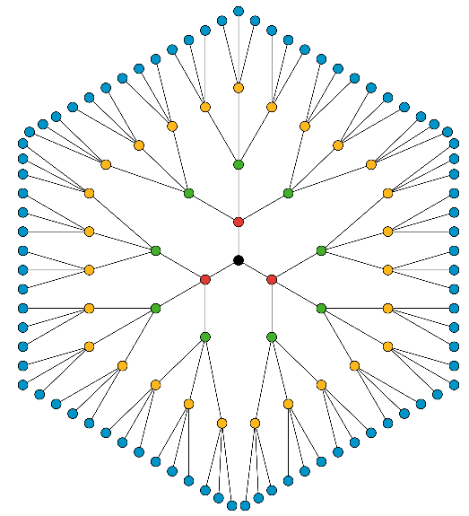
12.4.1 Warm-Up: Notice and Wonder
What do you notice about the image?
What do you wonder about the image?
volume 2, pg. 299

Slide 7

Collaboration
volume 2, pg. 300

Slide 8

12.4.2 Collaboration: Matching Activity
Part 1
Match each written description to the appropriate bar model, where the red portion is the result of the written description. Write the letter of the bar model beside the corresponding word description.
Written Description | Bar Model
1. Ten subtracted from a number
2. A number divided by ten
3. The sum of a number and ten
4. A number times ten
volume 2, pg. 300

Slide 9
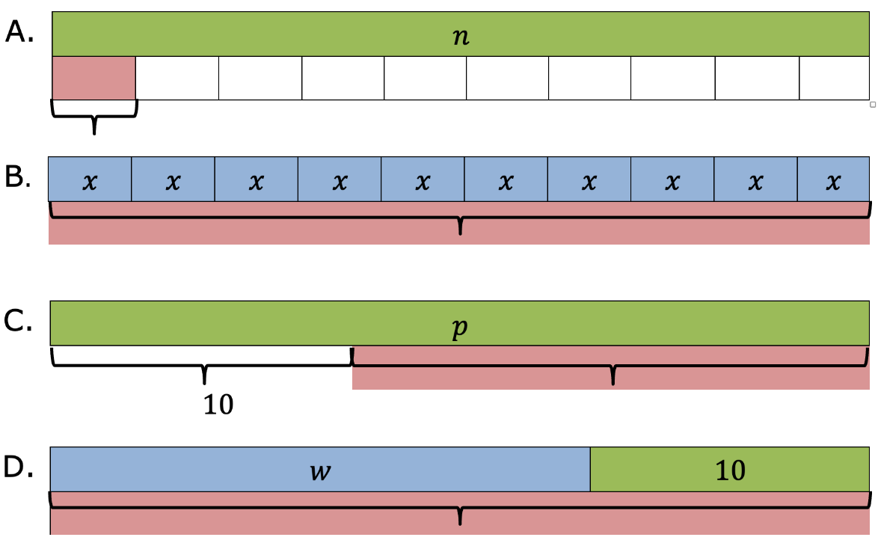
volume 2, pg. 300

Slide 10
Part 2
Turn and talk with your partner to compare your matches. Then, work with your partner to write an algebraic expression that represents the written description and bar model.
Written Description | Algebraic Expression
1. Ten subtracted from a number
2. A number divided by ten
3. The sum of a number and ten
4. A number times ten
volume 2, pg. 300

Slide 11

Guided Instruction
volume 2, pg. 301

Slide 12

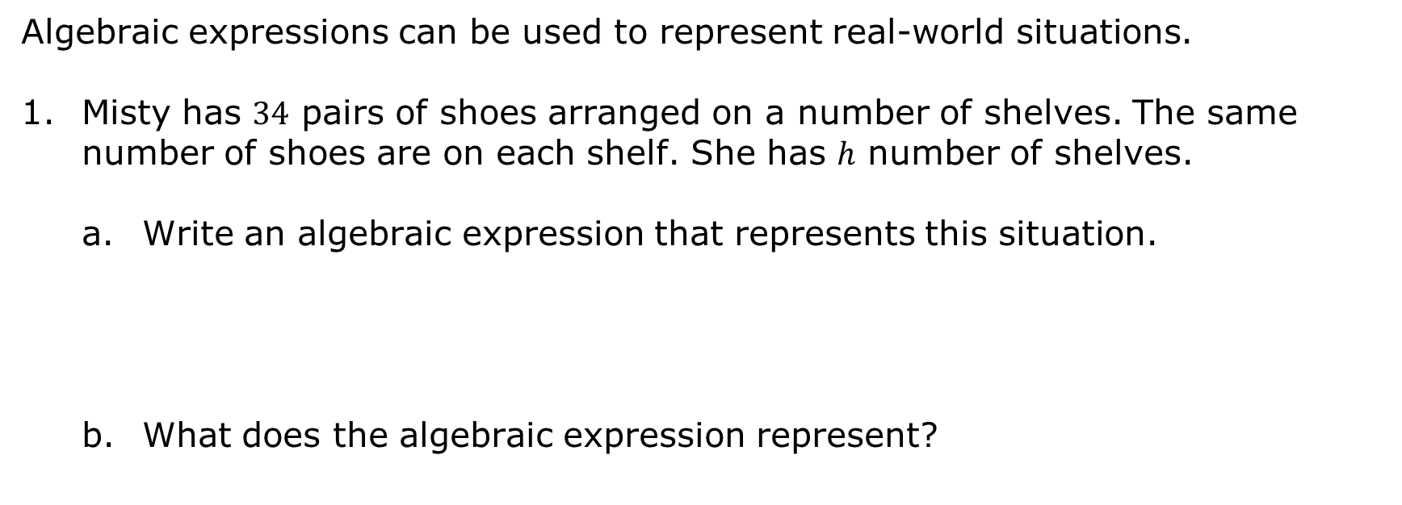
12.4.3 Guided Instruction: Writing Algebraic Expressions from Descriptions of Real-World Contexts
Algebraic expressions can be used to represent real-world situations.
Misty has $34$ pairs of shoes arranged on a number of shelves. The same number of shoes are on each shelf. She has ℎ number of shelves.
Write an algebraic expression that represents this situation.
What does the algebraic expression represent?
volume 2, pg. 301

Slide 13
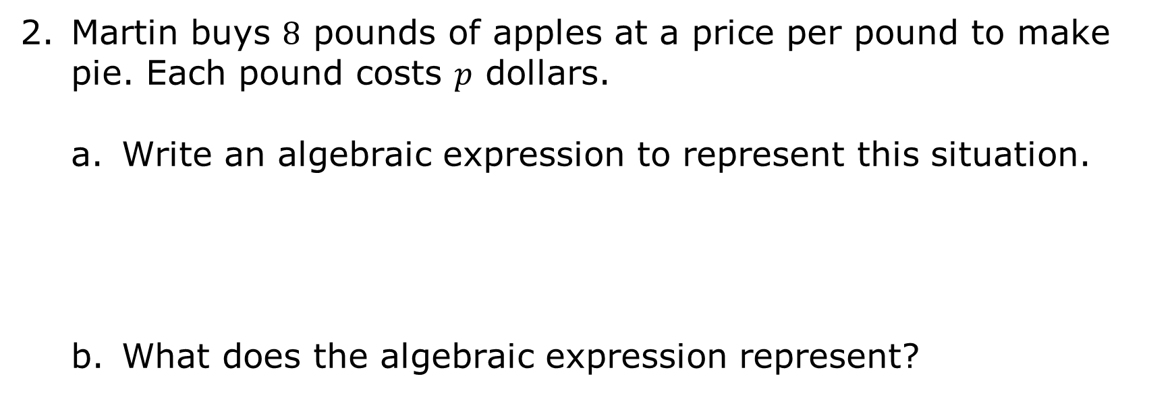
Martin buys $8$ pounds of apples at a price per pound to make pie. Each pound costs 𝑝 dollars.
Write an algebraic expression to represent this situation.
What does the algebraic expression represent?
volume 2, pg. 301

Slide 14
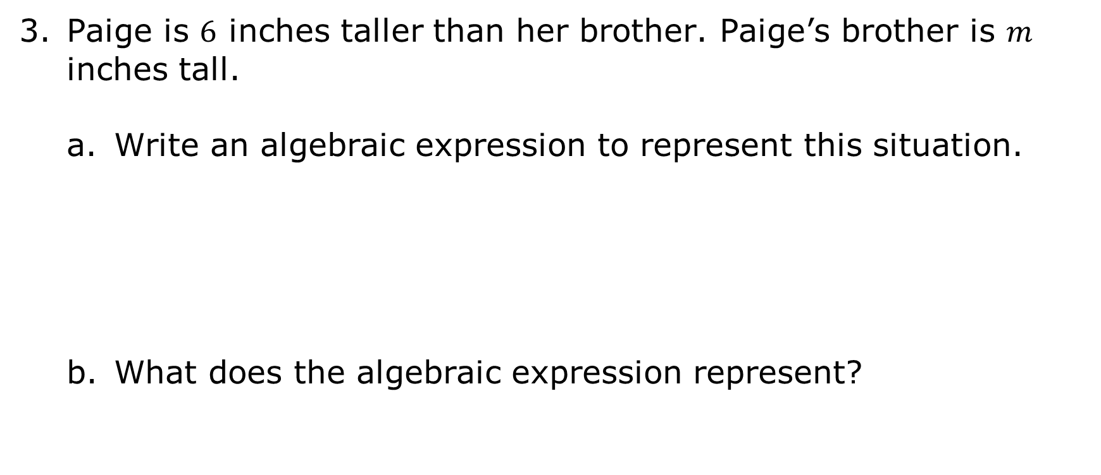
Paige is $6$ inches taller than her brother. Paige’s brother is 𝑚 inches tall.
Write an algebraic expression to represent this situation.
What does the algebraic expression represent?
volume 2, pg. 301

Slide 15
Collaboration
volume 2, pg. 302

Slide 16
12.4.4 Collaboration: Error Analysis
Nero was working on a matching activity where he was given written descriptions for a series of mathematical expressions. Nero had to create an algebraic expression for each description.
Below are three written descriptions with the algebraic expressions Nero wrote. Determine whether each expression is correct. If the expression is incorrect, explain why it isn’t correct and write the correct expression.
volume 2, pg. 302

Slide 17
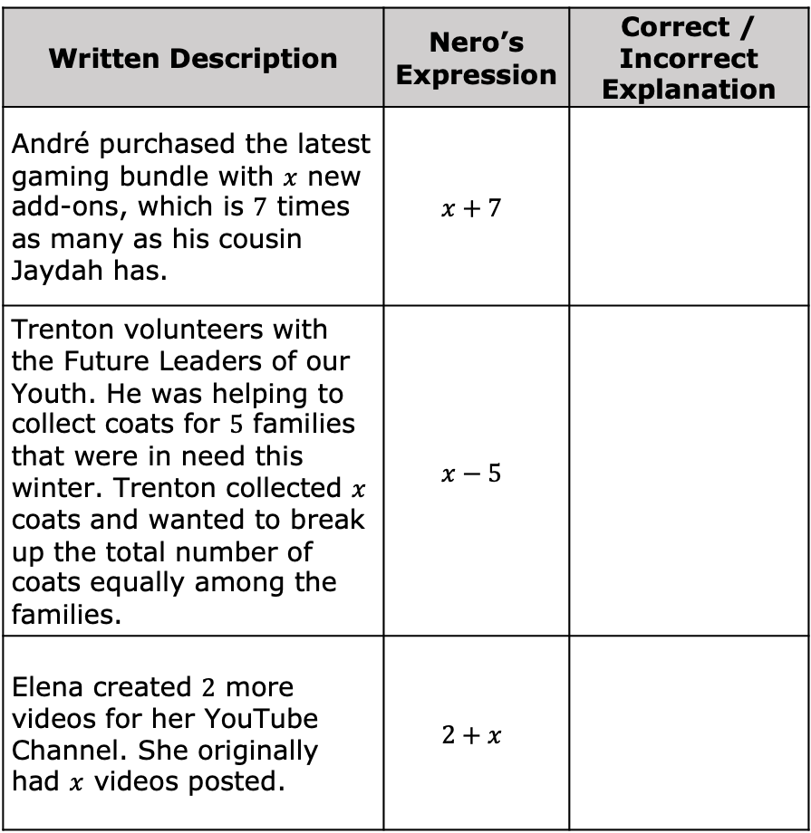
Written Description | Nero’s Expression | Correct / Incorrect Explanation
André purchased the latest gaming bundle with $x$ new add-ons, which is $7$ times as many as his cousin Jaydah has. | $$x+7$$
Trenton volunteers with the Future Leaders of our Youth. He was helping to collect coats for $5$ families that were in need this winter. Trenton collected $x$ coats and wanted to break up the total number of coats equally among the families. | $$x−5$$
Elena created $2$ more videos for her YouTube Channel. She originally had $x$ videos posted. | $$2+x$$
volume 2, pg. 302

Slide 18

Your Turn
volume 2, pg. 302

Slide 19

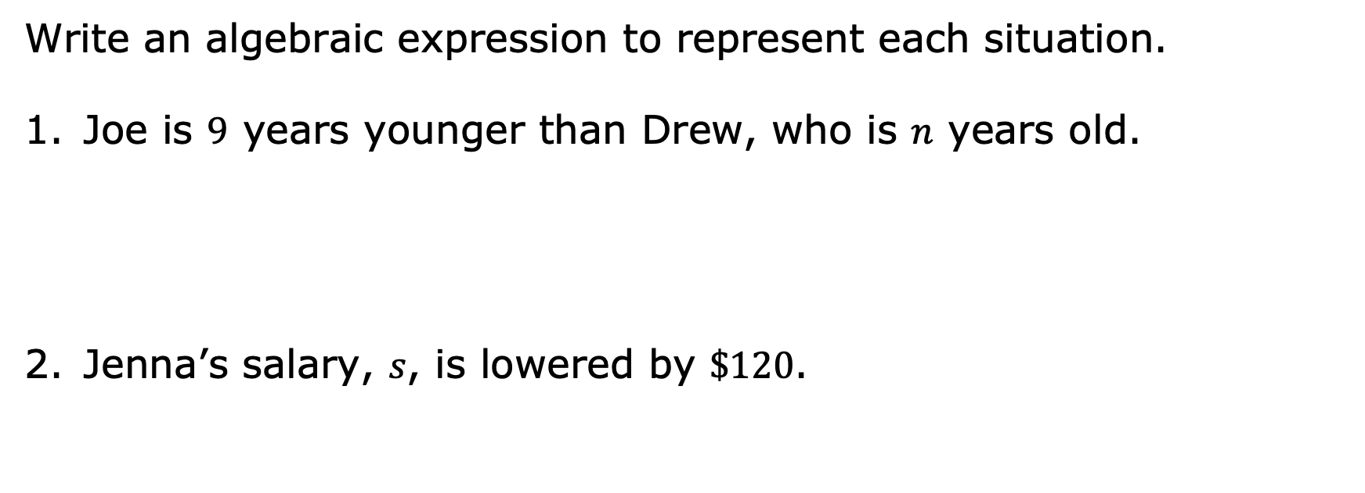
12.4.5 Your Turn!
Write an algebraic expression to represent each situation.
Joe is $9$ years younger than Drew, who is 𝑛 years old.
Jenna’s salary, 𝑠, is lowered by $\$120$.
volume 2, pg. 302

Slide 20

Maria has $12$ cupcakes and wants to split them among 𝑓 friends.
Target has $8$ cookie packages with 𝑐 cookies in each.
volume 2, pg. 302

Slide 21

Wrap-Up
volume 2, pg. 303

Slide 22
12.4.6 Wrap-Up: Growth Mindset
Write a note to yourself about a mistake you learned from today.
Means
I
Start
To
Acquire
Knowledge
Experience
Skills
volume 2, pg. 303

